Slide 1

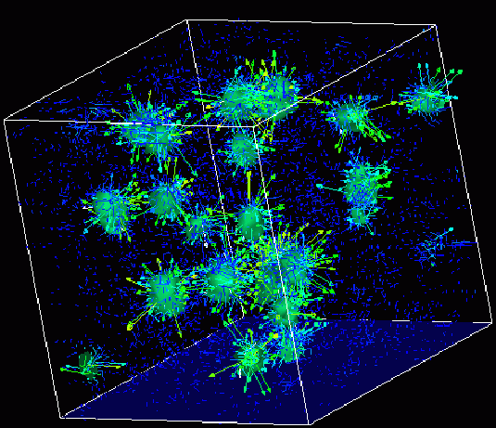
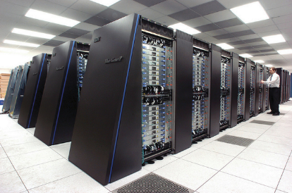
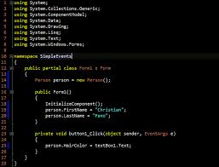
Survey of
Scientific Computing
(SciComp 301)
Dave Biersach
Brookhaven National Laboratory
dbiersach@bnl.gov
Exam 3
Total of 100 points

Slide 2
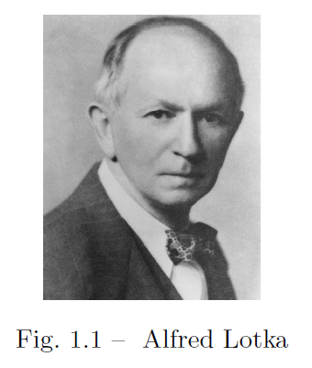
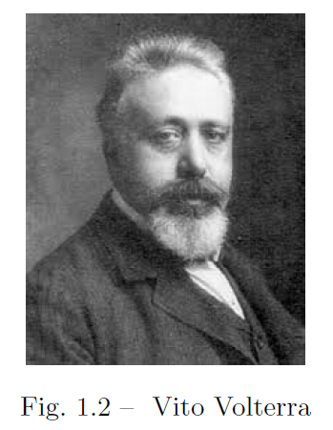
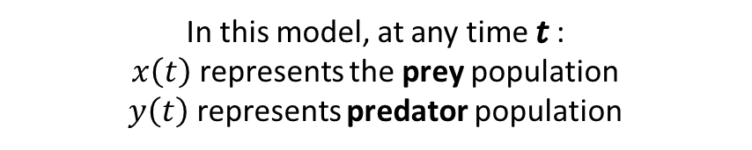


10 pts
1. Predator-Prey Modelling
https://en.wikipedia.org/wiki/Lotka%E2%80%93Volterra_equations
In the q01 folder, edit the C++ CERN ROOT application to visualize the Lotka-Volterra (1920) differential equations with given characteristics & initial conditions
$$α=2, β=1.1, γ=1.0, δ=0.9$$
$$x\left(0\right)=1, y\left(0\right)=0.5$$
In this model, at any time$t$ :
$x\left(t\right)$ represents the prey population
$y\left(t\right)$ represents predator population
The solution to their system of coupled non-linear first order differential equations will be numerically estimated using the 4th order Runge-Kutta method

Slide 3
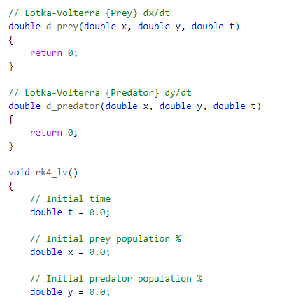


1. Predator-Prey Modelling
You must write this function
d_prey() = $\frac{dx}{dt}$
You must write this function
d_predator() = $\frac{dy}{dt}$
Provide these values

Slide 4
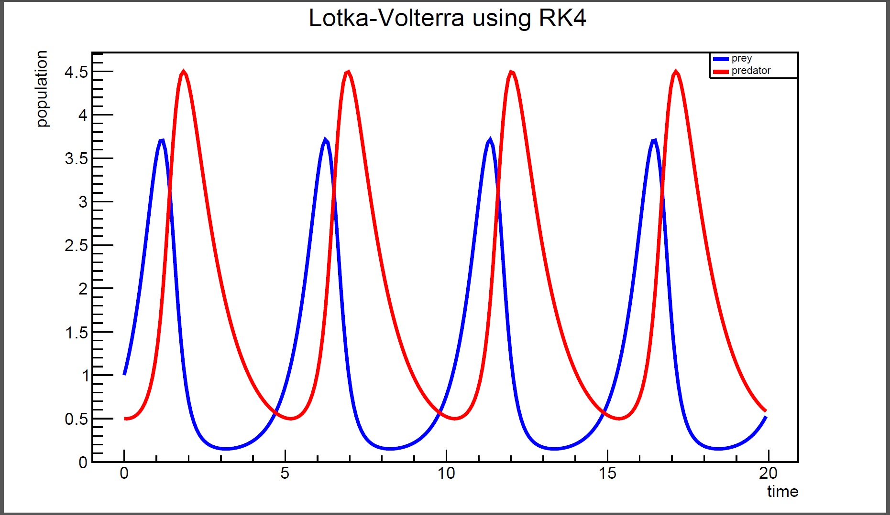
1. Predator-Prey Modelling
Expected Output (Approved Solution)

Slide 5
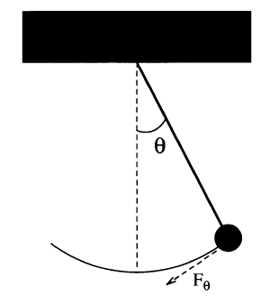

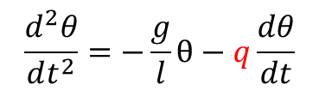

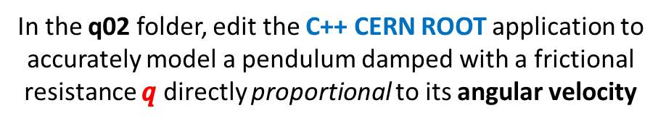




15 pts
2. Damped Pendulum
In the q02 folder, edit the C++ CERN ROOT application to accurately model a pendulum damped with a frictional resistance $q$ directly proportional to its angular velocity
Referring to Session 19 Lab 04, we must introduce an additional resistive force term into the equation of motion
$$q$$
$$\frac{d^{2}θ}{dt^{2}}=−\frac{g}{l}θ−q\frac{dθ}{dt}$$
Dampening force constant $q$
Euler-Cromer Difference Equations
$$\frac{dω}{dt}=−\frac{g}{l}θ−q\frac{dθ}{dt}$$
$$ω_{i+1}=ω_{i}−\frac{g}{l}θ_{i}Δt−{qω}_{i}Δt$$
$$\frac{dθ}{dt}=ω$$
$$θ_{i+1}=θ_{i}+ω_{i+1}Δt$$

Slide 6
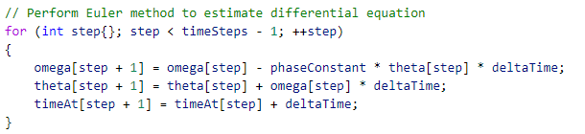


2. Damped Pendulum
Assume a damping factor $q=1$
$$ω_{i+1}=ω_{i}−\frac{g}{l}θ_{i}Δt−{qω}_{i}Δt$$
Add damping term
$$θ_{i+1}=θ_{i}+ω_{i+1}Δt$$
Insert Cromer’s correction

Slide 7
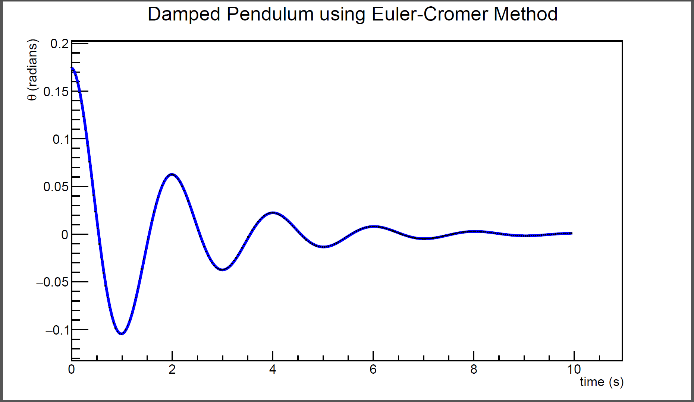
2. Damped Pendulum
Expected Output (Approved Solution)

Slide 8
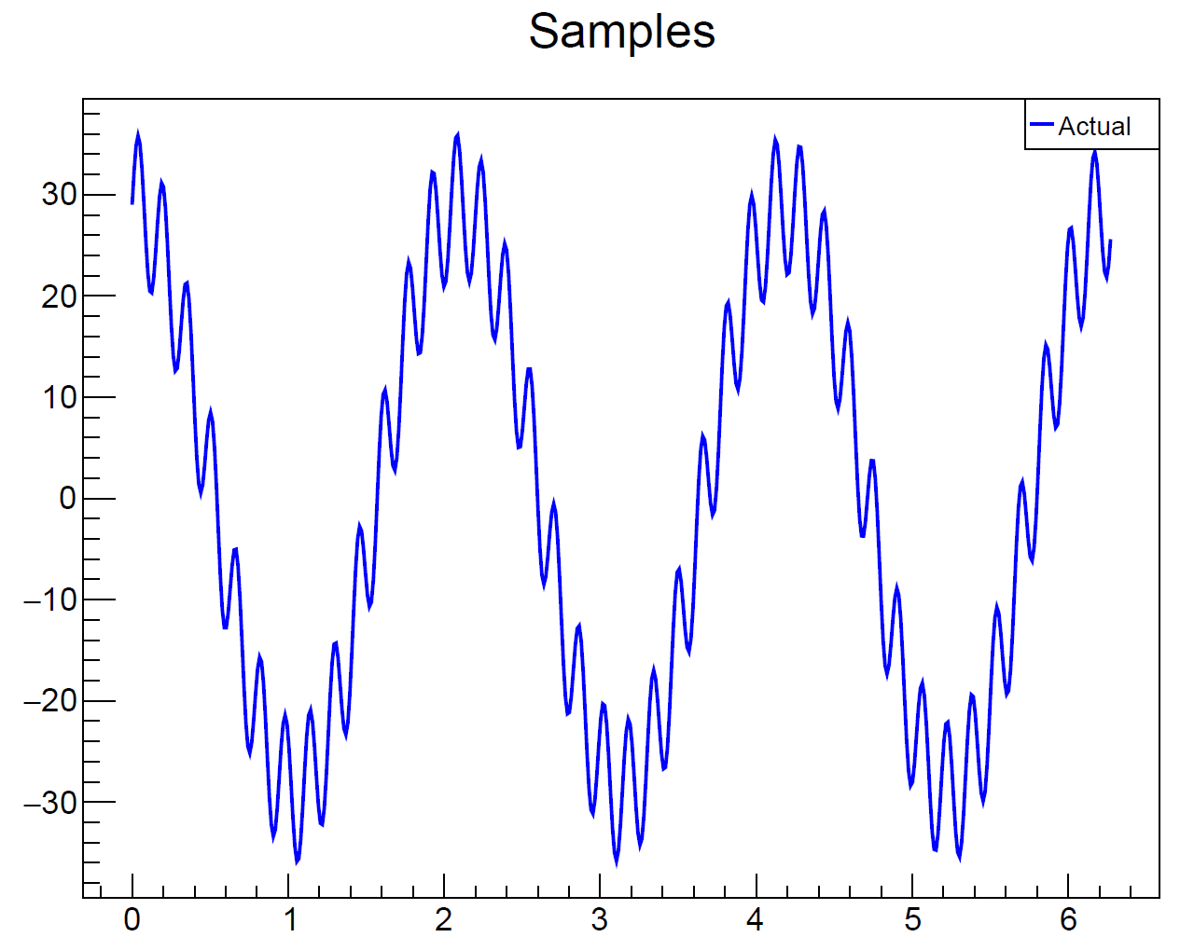
15 pts
3. High Frequency Filter
In the q03 folder, edit the C++ CERN ROOT application to filter out the high frequency noise embedded in a signal using the methods learned in Session 21
High frequency interference is distorting the capture of this clean primary signal
We want to remove this interference before using the inverse discrete Fourier transform (IDFT) to reconstruct the signal

Slide 9
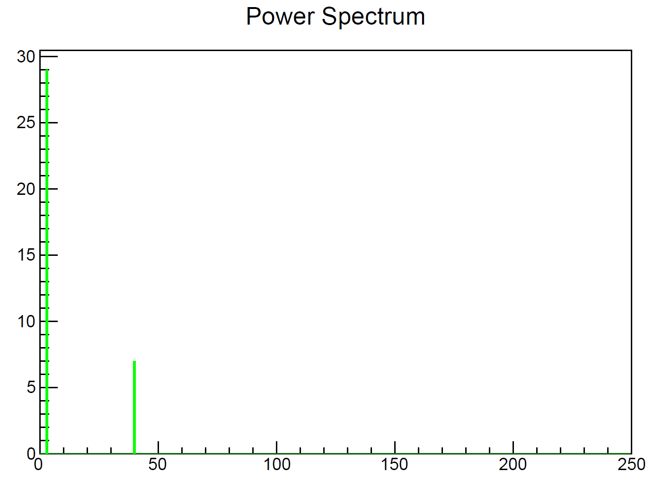
3. High Frequency Filter
The DFT identifies the constituent simple waves which compose a complicated wave
The interference can be filtered out by eliminating the simple waves that have a high frequency
This is the primary signal
This is the high frequency noise

Slide 10
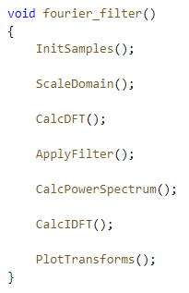
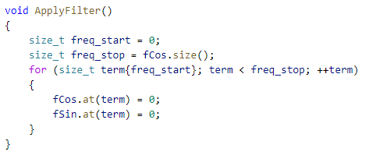
3. High Frequency Filter
Fix the bug in this code

Slide 11
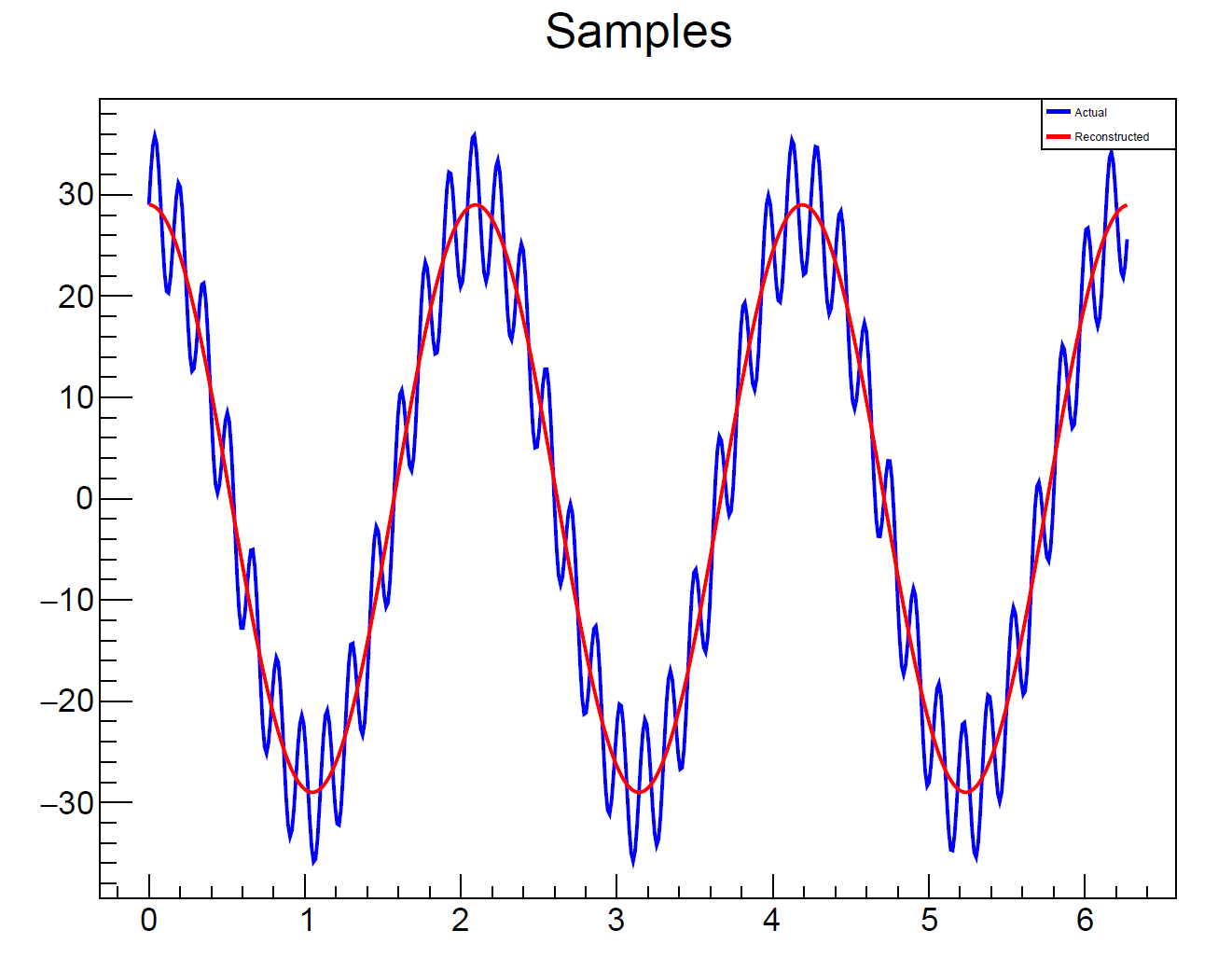
3. High Frequency Filter
Expected Output (Approved Solution)
The reconstructed signal (red) no longer has the high frequency noise

Slide 12
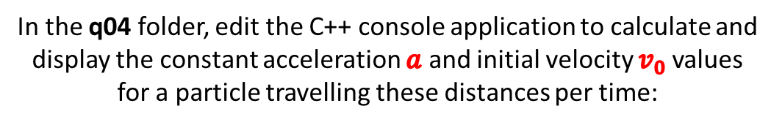
10 pts
4. Newtonian Kinematics
In the q04 folder, edit the C++ console application to calculate and display the constant acceleration $a$ and initial velocity $v_{0}$values for a particle travelling these distances per time:
Using the method of least squares, fit an appropriate quadratic equation from kinematics that governs the behavior of this particle
Assume SI units

Slide 13

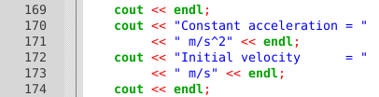
4. Newtonian Kinematics
Enter the given data
x = time, y = distance
Edit the code to display the correct values for the constant acceleration and initial velocity

Slide 14

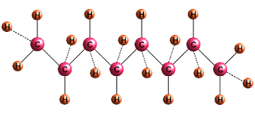
10 pts
5. Combustion of Octane
In the q05 folder, edit file octane.txt to correctly balance the combustion reaction equation of gasoline
Ensure the application emits the minimum molar ratios
Refer to Session 17 for assistance on how to encode a chemical equation into the expected input file format

Slide 15
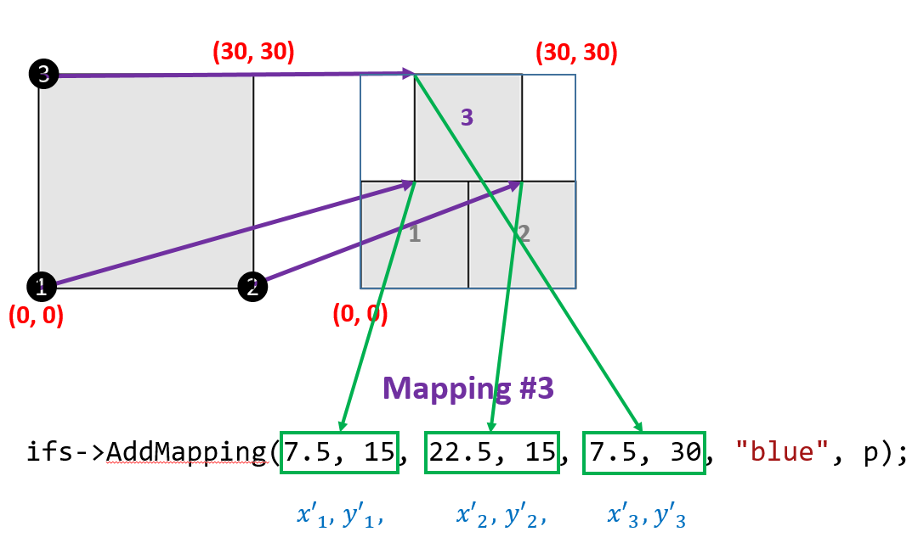
15 pts
6. Hexagonal Fractal
In the q06 folder, edit the C++ Allegro application to draw a hexagonal fractal using an Iterated Function System
Provide the final coordinates to create six affine transforms (mappings) that cover a regular hexagon with side length 10
Refer to Session 24 for assistance on how to encode mappings
This example is from Sierpiński's Triangle IFS

Slide 16
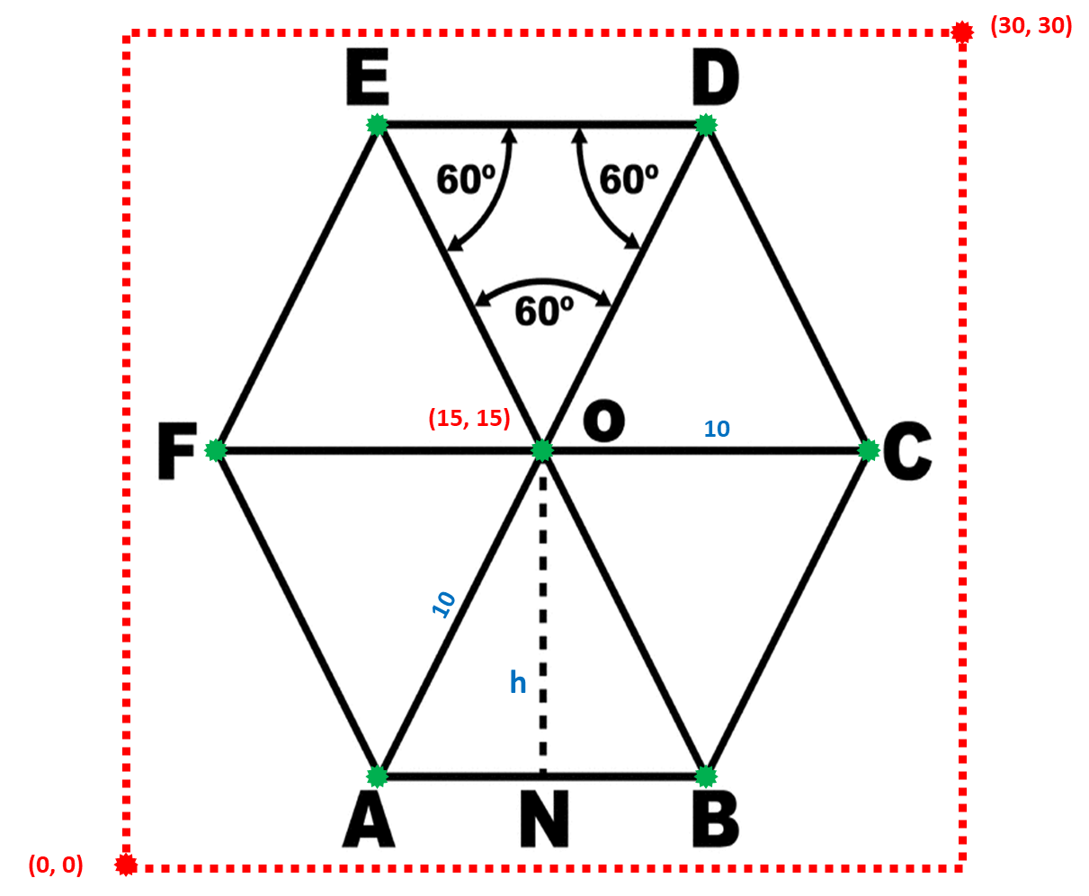
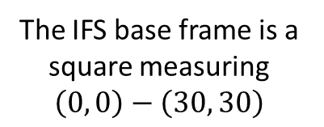
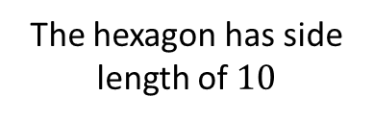
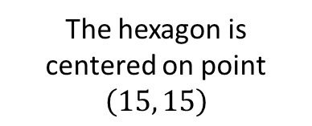
6. Hexagonal Fractal
The IFS base frame is a square measuring
$$\left(0, 0\right)−\left(30, 30\right)$$
The hexagon is centered on point
$$\left(15, 15\right)$$
The hexagon has side length of $10$

Slide 17
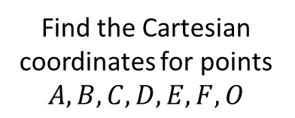
6. Hexagonal Fractal
Find the Cartesian coordinates for points $A,B,C,D,E,F,O$
Encode these six mappings:
COD
DOE
EOF
FOA
AOB
BOC

Slide 18
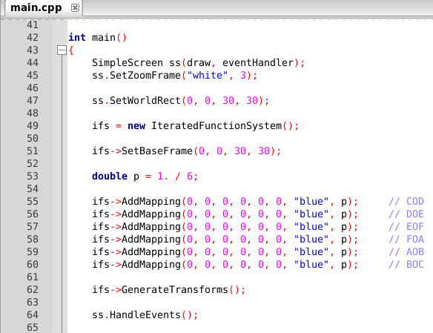
6. Hexagonal Fractal
Add & Edit Code
Here

Slide 19
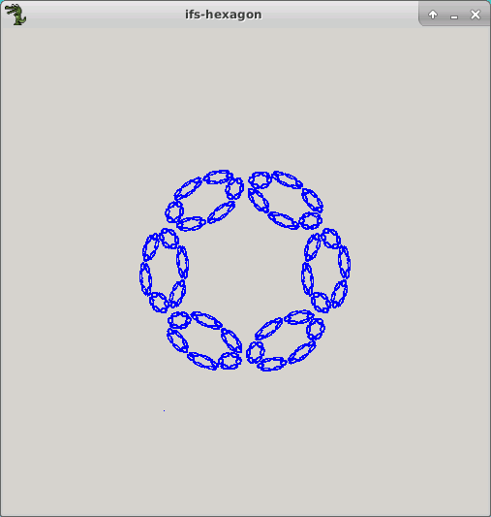
6. Hexagonal Fractal
This is just one possible solution

Slide 20
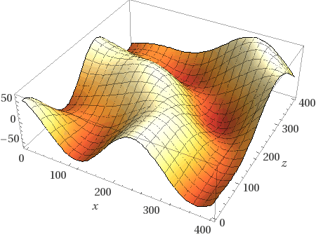
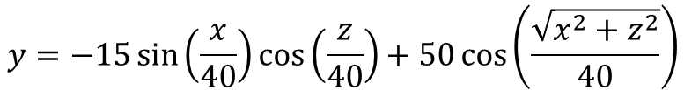
5 pts
7. Surface Interpolation
In the q07 folder, edit the C++ Allegro application to determine the optimal IDW power that minimizes the RMSD of this model
$$y=−15\sin\left(\frac{x}{40}\right)\cos\left(\frac{z}{40}\right)+50\cos\left(\frac{\sqrt{x^{2}+z^{2}}}{40}\right)⁡$$

Slide 21
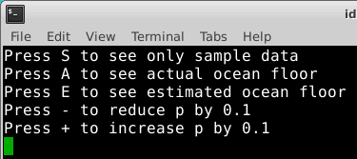

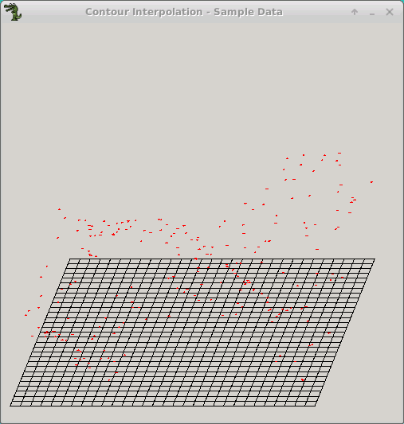
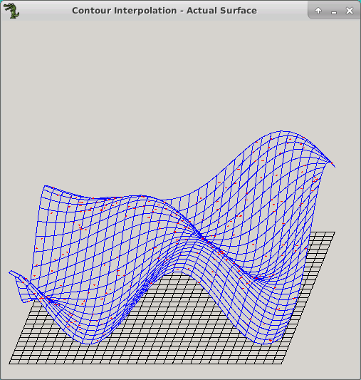
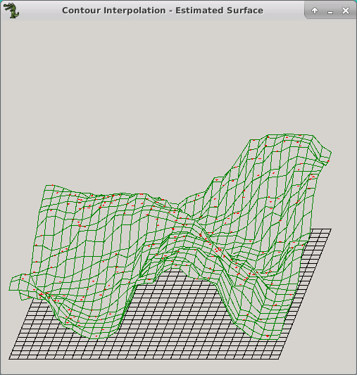
7. Surface Interpolation
Edit this function
This is the approved solution

Slide 22
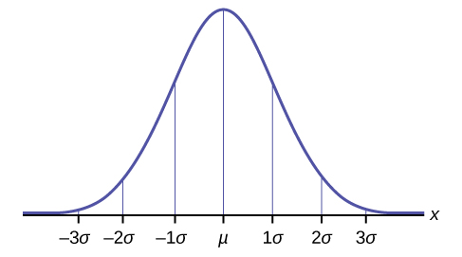
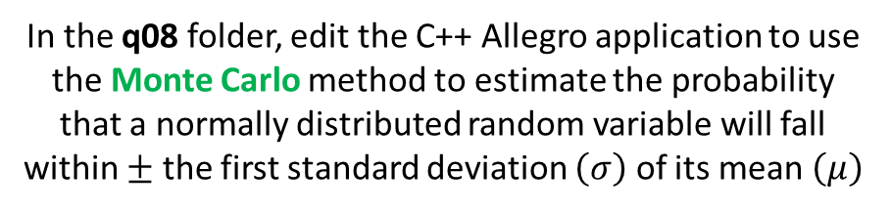
15 pts
8. Standard Normal Monte Carlo
In the q08 folder, edit the C++ Allegro application to use the Monte Carlo method to estimate the probability that a normally distributed random variable will fall within $±$ the first standard deviation $\left(σ\right)$ of its mean $\left(μ\right)$
The integral (the area under the curve) of a continuous probability distribution (CDF) indicates the probability an observation will fall within that interval
Assume we have a standard normal distribution for this problem!

Slide 23
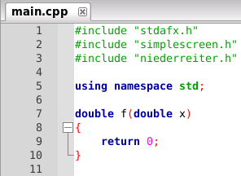
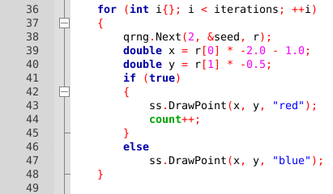
8. Standard Normal Monte Carlo
We will use the Niederreiter QRNG
Implement the function for a standard normal CDF
Edit this logic to only count points that are under the curve f(x)

Slide 24
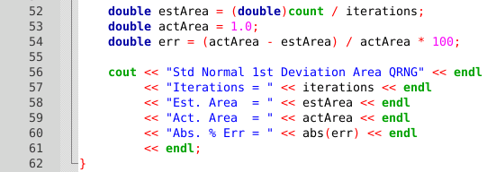
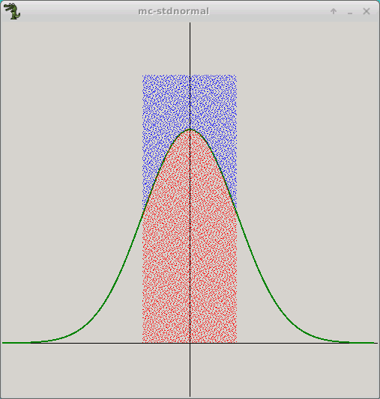

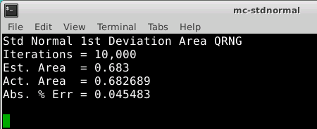

8. Standard Normal Monte Carlo
Insert the actual (expected) value for this area
$$\frac{{dots}_{inside}}{{dots}_{total}}=\frac{{area}_{under curve}}{{area}_{rectangle}}$$
Expected Output (Approved Solution)
0.5
2

Slide 25
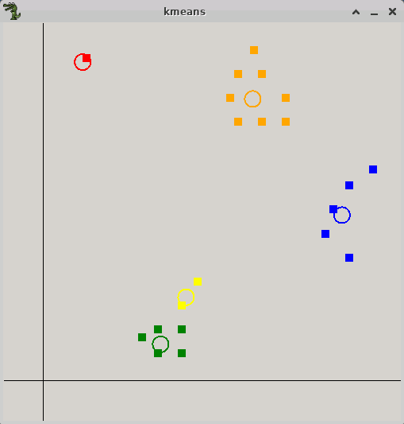



5 pts
9. kMeans Eviction Criteria
In the q09 folder, within the C++ Allegro application, edit the GetDistance() function to use the Manhattan (Taxicab) distance formula
When using three clusters, determine the proper value for the mean_multiple variable that eliminates the data outlier, but does not evict reasonable data points from their assigned cluster
$$1μ$$
$$4μ$$
5 clusters

Slide 26
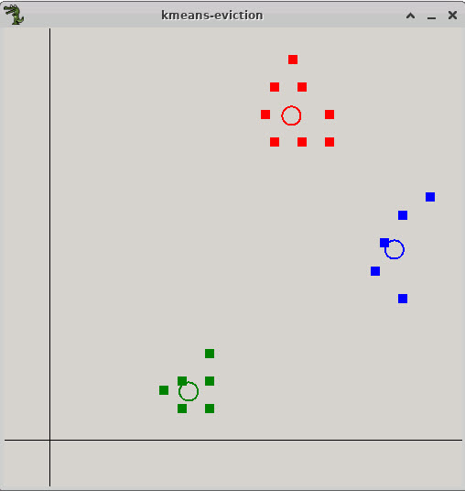
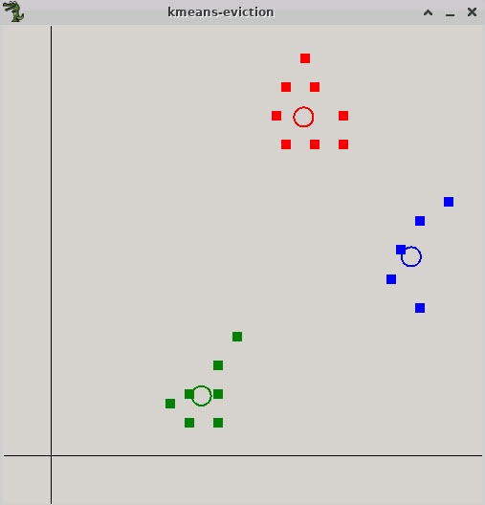
5 pts
9. kMeans Eviction Criteria
Incorrect mean_multiple
Correct mean_multiple

